Slide 1

Cloud Solution Templates

Slide 2
Why do I need F5’s Cloud Solution Templates?
Common Solutions Across Clouds
Tested & Validated
Simple & Automated
Manual configuration of app services is time consuming and prone to error
Templates designed and tested by F5 experts following cloud best practices.
VE Deployments in minutes
Templates Integrate with 3rd party automation tools such as Chef, Puppet & Ansible
Improves efficiency while reducing cost, variability and deployment risks
F5 is striving towards template parity across cloud vendors
Enabling fast & simple replication of app services across multiple cloud platforms.
Notes:
Tested & Validated: Manual configuration of app services is time consuming and prone to error; cloud solution templates deploy app services in minutes that have been designed and tested by F5 experts following cloud best practices.
Simple & Automated: As infrastructural complexity increases, the need for automation & orchestration intensifies. Templated app services can be easily integrated with 3rd party automation tools to improve efficiency while reducing cost, variability and risk of deployments.
Common Solutions Across Clouds: Multi-cloud is becoming more and more prominent; F5 provides cloud solution template parity across cloud vendors to enable fast & simple replication of app services across multiple cloud platforms.
Additional points:
No prior knowledge of BIG-IP required to deploy
Templates can also be customized to enable specific customer deployment requirements
Templates can be combined with VE evaluation licenses, decreasing time spent deploying and increasing time spent evaluating.

Slide 3

General Template Information
These templates simplify and speed up the deployment of BIG-IP VE’s in public cloud environments by packaging together all of the necessary resources and BIG-IP configuration parameters needed to launch fully functioning BIG-IP VE’s in a virtual cloud network.
This deck contains only ‘F5 supported’ templates, which are those that have been created, tested and verified by F5 Networks engineers, allowing customers to request assistance with them should they need it. There are also ‘Experimental’ templates on GitHub which have not been fully validated and are not subject to customer support.
All templates support BIG-IP v12.1.x through v13.1
All templates have built-in security checks, allowing customers to ensure the integrity of the template
All deployment times (both manual and templated times) stated in this deck are ESTIMATES, and assume the user has an intermediate level of experience with both the BIG-IP and the cloud platform in question. All times include boot time for the VE’s (~20mins). Pre-req’s are not included since they are required for both manual and templated deployments, but are adjudged to take around 15-20mins. It is important to note that with the more complex configurations such as the auto scaling solutions, somebody without BIG-IP or cloud experience would take much longer than the estimated times (magnitude of days to weeks) to replicate the set-up.

Slide 4
AWS Template Updates/Notes – Release 8
BIG-IP v13.1.0.2 Support
All supported templates now support BIG-IP v13.1.0.2
GovCloud Template Support
All supported templates can now be used to launch BIG-IP solutions in the AWS GovCloud region.

Slide 5
Azure Template Updates/Notes – Release 8
BIG-IP v13.1.0.2 Support
All supported templates now support BIG-IP v13.1.0.2
Upcoming Support for Azure Stack
Azure ARM templates can be used across both Azure and Azure Stack, however, Azure Stack currently only supports 1NIC instances. As such only the Standalone 1NIC template will be supported in Azure Stack at launch. As the Azure Stack platform matures, more of F5’s ARM templates will be supported.

Slide 6
Google Template Updates/Notes – Release 8
BIG-IP v13.1.0.2 Support
All supported templates now support BIG-IP v13.1.0.2
Standalone 1NIC, 2NIC & 3NIC Hourly Templates
Deploy standalone, pay-as-you-go BIG-IP VE instances in GCP with 1, 2 or 3 network interfaces.
Standalone 2NIC & 3NIC BYOL Templates
Deploy standalone BYOL BIG-IP VE instances in GCP with 2 or 3 network interfaces.
Service Discovery
All supported templates now support service discovery of workloads.

Slide 7
Supported Public Cloud Solution Templates
1NIC Architecture
2NIC Architecture
3NIC Architecture
2 Clustered BIG-IP’s (Same AZ)
2 Clustered BIG-IP’s (Across AZ)
Auto Scale Cloud WAF (Gbps & vCPU)
Auto Scale Cloud LTM (Gbps & vCPU)
1NIC Architecture
2NIC Architecture
3NIC Architecture
n-NIC Architecture
2 Clustered BIG-IP’s (A/A 1NIC)
HA Pair (A/S 3NIC)
Auto Scale Cloud WAF (Gbps & vCPU)
Auto Scale Cloud LTM (Gbps & vCPU)
1NIC Architecture
2NIC Architecture
3NIC Architecture

Slide 8
Cloud Solution Templates by Use Case
Application Security
Auto Scale Cloud WAF [AWS, Azure]
Advanced Traffic Management
Auto Scale Cloud LTM [AWS, Azure]
Deployment Topologies
1NIC VE Deployment [AWS, Azure, Google, OpenStack]
2NIC VE Deployment [AWS, Azure, Google, OpenStack]
3NIC VE Deployment [AWS, Azure, Google]
n-NIC VE Deployment [Azure, OpenStack]
HA (Active/Active) [AWS, Azure]
HA (Active/Standby) [Azure, OpenStack]

Slide 9
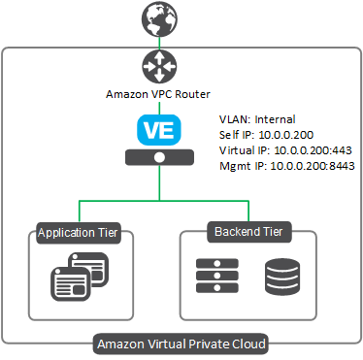
1-NIC BIG-IP VE Deployment on AWS
For deploying a single, standalone BIG-IP device with one network interface
Deploys a standalone BIG-IP VE in a pre-existing AWS VPC, where traffic automatically flows via the VE to the application servers. The BIG-IP instance operates with 1 network interface, processing both management and data plane traffic from the internet. This is the set-up most cloud native developers are accustom to and is best for single tenant or ‘per app’ services.
BYOL and PAYG templates available
Pre-requisites to this template can be found here
Manual Deployment ~ 3+ hours
Templated Deployment ~ 40 mins
Link to GitHub

Slide 10
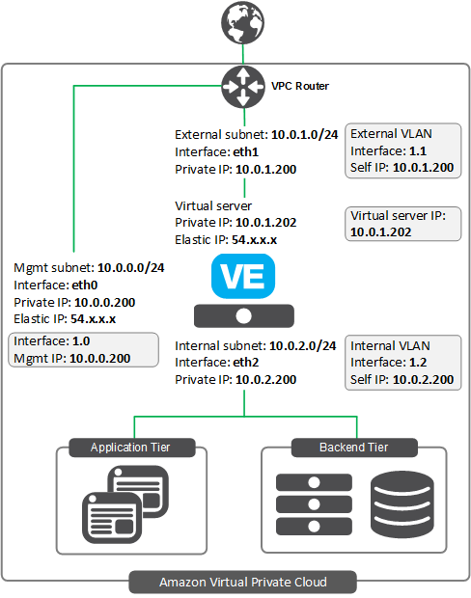
2-NIC BIG-IP VE Deployment on AWS
For deploying single, standalone BIG-IP device(s) with two network interfaces
Deploys a standalone BIG-IP VE in a pre-existing AWS VPC, where traffic automatically flows via the VE to the application servers. The BIG-IP instance operates with 2 network interfaces, One for management & data-plane traffic from the internet and another for traffic from the AWS network providing greater autonomy to control the management functions
BYOL and PAYG templates available
Pre-requisites to this template can be found here
Manual Deployment ~ 3+ hours
Templated Deployment ~ 40 mins
Link to GitHub

Slide 11
3-NIC BIG-IP VE Deployment on AWS
For deploying single, standalone BIG-IP device(s) with two network interfaces
Deploys a standalone BIG-IP VE in a pre-existing AWS VPC, where traffic automatically flows via the VE to the application servers. The BIG-IP VE instance operates with 3 network interfaces and is most similar to an ‘on-premise’ deployment, with one interface for management, one for front-end application traffic and one for back end application traffic
Multi-NIC configurations are necessary when deploying multiple applications on different IP addresses, or multi-tenant configurations.
BYOL and PAYG templates available
Pre-requisites to this template can be found here
Manual Deployment ~ 3+ hours
Templated Deployment ~ 40 mins
Link to GitHub

Slide 12
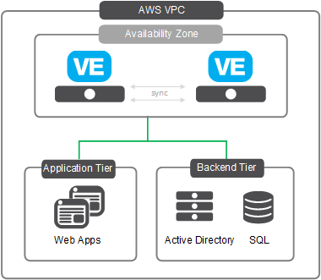
Clustered Deployment of 2 BIG-IP VE’s on AWS (Same AZ)
For deploying BIG-IP’s in parallel in the same AZ for increased availability
Launches and configures two BIG-IP VE’s in a single availability zone in an Active-standby arrangement for high availability, such that should one BIG-IP fail, traffic is automatically re-directed to the unaffected device until the issue is resolved.
The BIG-IP instance operates with 2 network interfaces:
One for management & data-plane traffic from the internet
Another for traffic from the AWS network
BYOL and PAYG templates available
Pre-requisites to this template can be found here
Manual Deployment ~ 8+ hours
Templated Deployment ~ 40 mins
Link to GitHub

Slide 13
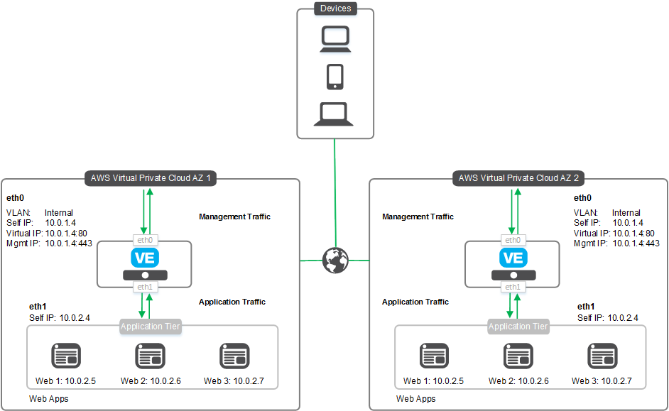
Clustered Deployment of 2 BIG-IP VE’s on AWS (Across AZ)
For deploying BIG-IP’s in parallel across AZ’s for further enhanced availability
Launches and configures two BIG-IP VE’s in 2 separate availability zones (AZ) in an active-standby arrangement for high availability, such that should one AZ fail, public traffic is automatically re-directed to the unaffected one.
The BIG-IP instance operates with 2 network interfaces:
One for management & data-plane traffic from the internet
Another for traffic from the AWS network
BYOL and PAYG templates available
Pre-requisites to this template can be found here
Manual Deployment ~ 8+ hours
Templated Deployment ~ 40 mins
Link to GitHub

Slide 14
Auto Scale WAF deployment on AWS
For consistent application protection regardless of traffic volume or CPU utiiization
Launches a PAYG BIG-IP VE instance with LTM and ASM provisioned for intelligent traffic management and application security. As traffic or vCPU consumption fluctuates, identical instances are automatically spun up or down to provide the optimal solution for processing application traffic.
The BIG-IP instances operate with 1 network interface
Scale up & Scale down events based on a pre-defined % of traffic or vCPU thresholds, typically 80% for scale up, 20% for scale down.
AWS resources required include: S3 bucket, IAM role, CloudWatch, Auto Scale Group and SNS Topic.
Available with PAYG instances or with BYOL licenses when used in conjuction with BIG-IQ License Manager (free).
Pre-requisites to this template can be found here
Manual Deployment ~ 7+ hours
Templated Deployment ~ 40 mins
Link to GitHub

Slide 15
Auto Scale BIG-IP LTM deployment on AWS
For consistent application protection regardless of traffic volume or CPU utilization
Deploys BIG-IP LTM in an Auto Scaling group, to consistently provide intelligent traffic management services to applications under varying traffic loads. As traffic or vCPU consumption fluctuates, identical instances are automatically spun up or down to provide the optimal solution for processing application traffic.
BIG-IP instances operate with 1 network interface
Scale up & Scale down event triggers based on a pre-defined % of traffic or vCPU thresholds, typically 80% for scale up, 20% for scale down.
AWS resources required include: S3 bucket, IAM role, CloudWatch, Auto Scale Group and SNS Topic.
Available with PAYG instances or with BYOL licenses when used in conjuction with BIG-IQ License Manager (free).
Pre-requisites to this template can be found here
Manual Deployment ~ 6+ hours
Templated Deployment ~ 40 mins
Link to GitHub

Slide 16
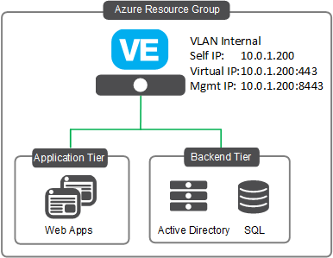
1-NIC BIG-IP VE Deployment in Azure/Azure Stack
For deploying a single, standalone BIG-IP device with one network interface
Deploys a standalone BIG-IP VE in a new or pre-existing Azure virtual network, where traffic automatically flows via the VE to the application servers. The BIG-IP instance operates with 1 network interface, processing both management and data plane traffic from the internet. This is the set-up most cloud native developers are accustom to and is best for single tenant or ‘per app’ services.
BYOL and PAYG templates available
Pre-requisites to this template can be found here
Link to GitHub
Manual Deployment ~ 3+ hours
Templated Deployment ~ 40 mins

Slide 17
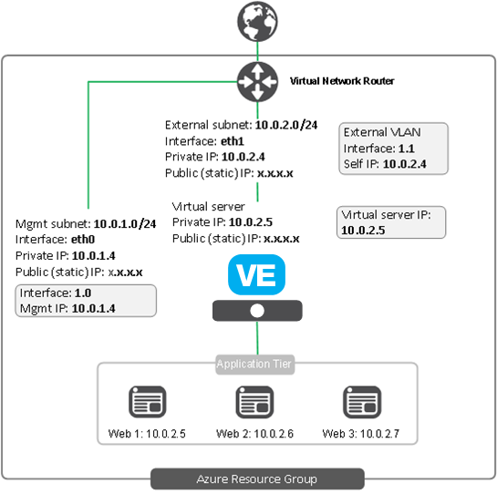
2-NIC BIG-IP VE Deployment in Azure
For deploying single, standalone BIG-IP device(s) with two network interfaces
Deploys a standalone BIG-IP VE in a new or pre-existing Azure virtual network, where traffic automatically flows via the VE to the application servers. The BIG-IP instance operates with 2 network interfaces, one for management & data-plane traffic from the internet and another for traffic from the AWS network providing greater autonomy to control the management functions
Multiple public/private IP addresses available per NIC
BYOL and PAYG templates available
Pre-requisites to this template can be found here
Link to GitHub
Manual Deployment ~ 3+ hours
Templated Deployment ~ 40 mins

Slide 18
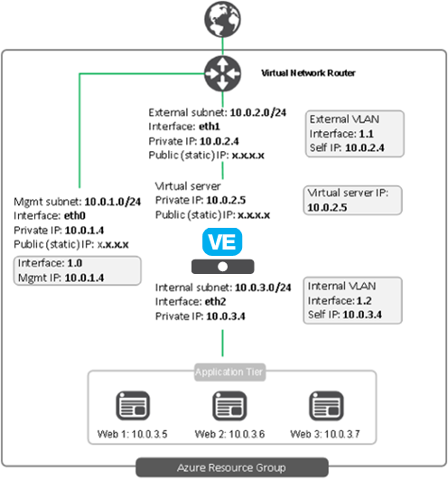
3-NIC BIG-IP VE Deployment in Azure
For deploying single, standalone BIG-IP device(s) with three network interfaces
Deploys a standalone BIG-IP VE in a new or pre-existing Azure virtual network, where traffic automatically flows via the VE to the application servers. The BIG-IP VE instance operates with 3 network interfaces and is most similar to an ‘on-premise’ deployment, with one interface for management, one for front-end application traffic and one for back end application traffic
Multi-NIC configurations are necessary when deploying multiple applications on different IP addresses, or multi-tenant configurations.
BYOL and PAYG templates available
Pre-requisites to this template can be found here
Link to GitHub
Manual Deployment ~ 3+ hours
Templated Deployment ~ 40 mins

Slide 19
Multi-NIC BIG-IP VE Deployment in Azure
For deploying single, standalone BIG-IP device(s) with 3+ network interfaces
Deploys a standalone BIG-IP VE in a new or existing Azure virtual network, where traffic automatically flows via the VE to the application servers. The BIG-IP VE instance is launched with 3 network interfaces but the template has the capability to add additional interfaces (up to a total of 8). This template is useful when the VE is acting as a traffic controller requiring more than 3 interfaces.
Multi-NIC configurations are necessary when deploying multiple applications on different IP addresses, or multi-tenant configurations.
BYOL and PAYG templates available
Pre-requisites to this template can be found here
Manual Deployment ~ 3+ hours
Templated Deployment ~ 40 mins
Link to GitHub

Slide 20
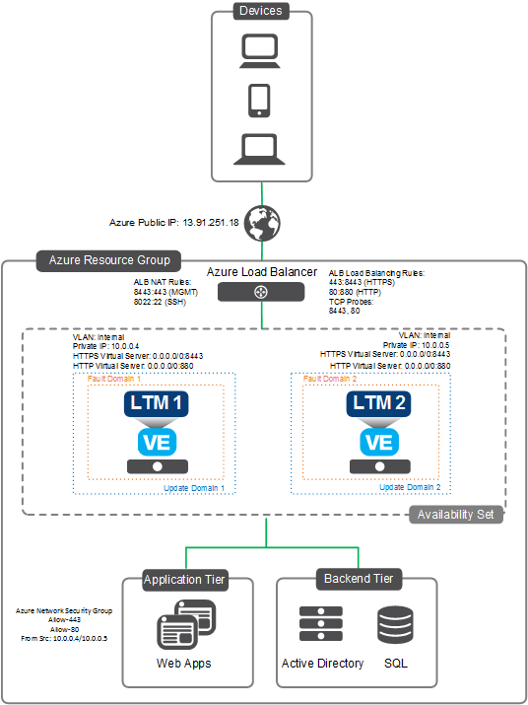
Clustered deployment of 2 BIG-IP VE’s in Azure (1NIC)
For deploying BIG-IP VE’s in parallel for increased availability
Deploys two BIG-IP VE’s across an Azure availability set in an Active-Active configuration for enhanced availability. The BIG-IP’s are configured in front of pre-existing application servers, and thus traffic traverses the BIG-IP’s to these servers.
The BIG-IP VE instance operates with 1 network interface used for both management and data plane traffic.
Requires use of an Azure Load Balancer
BYOL and PAYG templates available
Pre-requisites to this template can be found here
Link to GitHub
Manual Deployment ~ 8+ hours
Templated Deployment ~ 40 mins

Slide 21
Clustered deployment of 2 BIG-IP VE’s in Azure (3NIC)
For deploying BIG-IP VE’s in parallel for increased availability
Deploys two BIG-IP VE’s across an Azure availability set in an Active-Active configuration for enhanced availability. The BIG-IP’s are configured in front of pre-existing application servers, and thus traffic traverses the BIG-IP’s to these servers.
The BIG-IP VE instance operates with 3 network interfaces, with one interface for management, one for front-end application traffic and one for back end application traffic
Requires use of an Azure Load Balancer
BYOL and PAYG templates available
Pre-requisites to this template can be found here
Link to GitHub
Manual Deployment ~ 8+ hours
Templated Deployment ~ 40 mins

Slide 22
HA Pair in Azure Availability Set
For deploying BIG-IP VE’s in active/standby for increased availability
Deploys two BIG-IP VE’s in an Active-Standby configuration to ensuring high availability in both cases. The VE’s are within an Azure availability set allowing them to be spread across different update and fault domains. The VE’s can be added to an existing Azure stack or can be deployed into a new stack.
Each VE has 3 Network interfaces, and is most similar to an ‘on-premise’ deployment, with one interface for management, one for front-end application traffic and one for back end application traffic
Does not require use of an Azure Load Balancer
PAYG & BYOL templates available
Pre-requisites to this template can be found here
Link to GitHub
Manual Deployment ~ 8+ hours
Templated Deployment ~ 40 mins

Slide 23
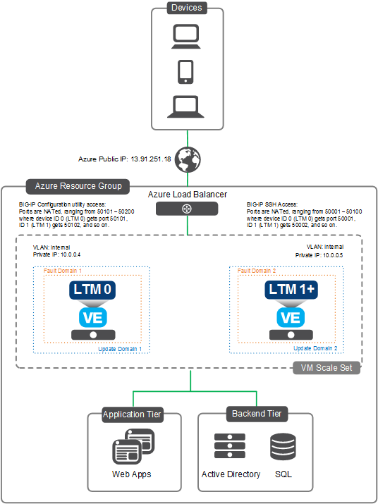
Auto Scale BIG-IP LTM Deployment in Azure
For deploying an optimized application availability solution
Deploys BIG-IP LTM in an Auto Scaling group, to consistently provide intelligent traffic management services to applications under varying traffic loads or vCPU strain. As traffic or vCPU utilization increases or decreases and crosses pre-defined thresholds, BIG-IP LTM instances are either spun up or spun down, accordingly.
This solution can be deployed into a new or existing stack.
The BIG-IP VE instance operates with 1 network interface used for both management and data plane traffic.
Requires use of an Azure Load Balancer (ALB)
Multiple email addresses can be added to templates to receive notifications when scaling events occur
Scaling events based on either traffic throughput or vCPU consumption
Available with PAYG instances or with BYOL licenses when used in conjuction with BIG-IQ License Manager (free).
Pre-requisites to this template can be found here
Manual Deployment ~ 6+ hours
Templated Deployment ~ 40 mins
Link to GitHub

Slide 24
Auto Scale WAF Deployment in Azure
For deploying an optimized application availability solution
Deploys BIG-IP with LTM/ASM provisioned in an Auto Scaling group, to consistently provide intelligent traffic management services to applications under varying traffic loads or vCPU strain As traffic or vCPU utilization increases or decreases and crosses pre-defined thresholds, BIG-IP LTM instances are either spun up or spun down, accordingly.
This solution is deployed into a new networking stack which is created along with the solution.
The BIG-IP VE instance operates with 1 network interface used for both management and data plane traffic.
Requires use of an Azure Load Balancer (ALB)
Multiple email addresses can be added to templates to receive notifications when scaling events occur
Scaling events based on either traffic throughput or vCPU consumption
Available with PAYG instances or with BYOL licenses when used in conjuction with BIG-IQ License Manager (free).
Pre-requisites to this template can be found here
Manual Deployment ~ 6+ hours
Templated Deployment ~ 40 mins
Link to GitHub

Slide 25
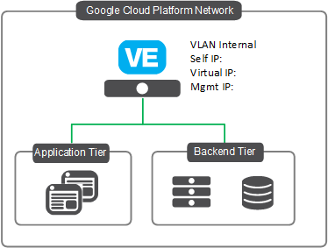
1-NIC BIG-IP VE Deployment in Google
For deploying a single, standalone BIG-IP device with one network interface
Deploys a standalone BIG-IP VE in a pre-existing Google virtual network, where traffic automatically flows via the VE to the application servers. The BIG-IP instance operates with 1 network interface, processing both management and data plane traffic from the internet. This is the set-up most cloud native developers are accustom to and is best for single tenant or ‘per app’ services.
BYOL and PAYG templates available
Pre-requisites to this template can be found here
Manual Deployment ~ 3+ hours
Templated Deployment ~ 40 mins
Link to GitHub

Slide 26
2-NIC BIG-IP VE Deployment on Google
For deploying single, standalone BIG-IP device(s) with two network interfaces
Deploys a standalone BIG-IP VE into a Google VPC, where traffic automatically flows via the VE to the application servers. The BIG-IP instance operates with 2 network interfaces, One for management & data-plane traffic from the internet and another for traffic from the AWS network providing greater autonomy to control the management functions
BYOL and PAYG templates available
Pre-requisites to this template can be found here
Google Cloud VPC
Manual Deployment ~ 3+ hours
Templated Deployment ~ 40 mins
Link to GitHub

Slide 27
3-NIC BIG-IP VE Deployment in Google
For deploying single, standalone BIG-IP device(s) with two network interfaces
Deploys a standalone BIG-IP VE in a Google VPC, where traffic automatically flows via the VE to the application servers. The BIG-IP VE instance operates with 3 network interfaces and is most similar to an ‘on-premise’ deployment, with one interface for management, one for front-end application traffic and one for back end application traffic
Multi-NIC configurations are necessary when deploying multiple applications on different IP addresses, or multi-tenant configurations.
BYOL and PAYG templates available
Pre-requisites to this template can be found here
Google Cloud VPC
Manual Deployment ~ 3+ hours
Templated Deployment ~ 40 mins
Link to GitHub

Slide 28
Integrated Marketplace Solutions

Slide 29
Integrated Marketplace Solutions: The Basics
These solutions are available direct from each cloud vendor’s respective marketplace and run off of F5 created cloud solution templates, which essentially aggregate together all of the necessary resources and BIG-IP configuration parameters needed to launch these fully functioning F5 solutions in a customers virtual cloud network.
At this point, solutions are available for AWS and Azure for multiple different use case scenarios.
All deployment times (both manual and templated times) stated in this deck are ESTIMATES, and assume the user has an intermediate level of experience with both the BIG-IP and the cloud platform in question. All times include boot time for the VE’s (~20mins). Pre-req’s are not included since they are required for both manual and templated deployments, but are adjudged to take around 15-20mins
All solutions now support BIG-IP v13.1

Slide 30
Integrated Marketplace Solutions: The Value
These solutions speed up the deployment of specific BIG-IP VE configurations as well as reducing complexity; deploying fully configured solutions in a matter of minutes and just a few clicks.
Deployable direct from the marketplace for simplified consumption of F5 services
No prior knowledge of the BIG-IP system required to implement, and allows a customer to deploy their VE’s confidently, in the knowledge that the pre-configured solutions have been designed following best practices by F5 experts.
Automate VE deployments by integrating solutions with cloud native or 3rd party automation tools

Slide 31
Integrated Marketplace Solutions by Use Case
Application Security
WAF Solution (Inside Azure Security Center) [Azure]
WAF Solution [Azure]
Auto Scale WAF Solution [AWS, Azure]
Application Access
Federated Access to Office365 Applications [Azure]
Advanced Traffic Management
Auto Scale Cloud LTM [Azure]

Slide 32
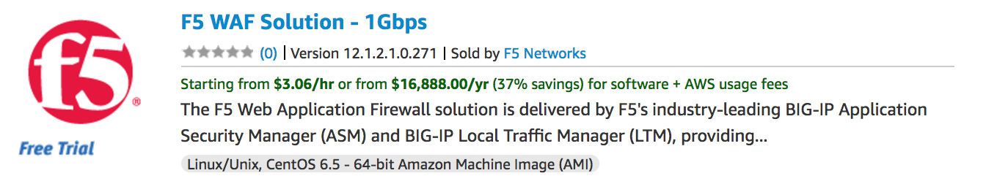
Auto Scale WAF Solution for AWS
Optimize application security and operational expenditure
Deploys VE instances with BIG-IP LTM and ASM provisioned in an AWS auto scaling group to provide intelligent traffic management and application security services to applications under varying traffic loads. Instances scale up or down depending on traffic throughput, ensuring application security and operational expenditure are optimized. As traffic passes pre-defined thresholds, instances are spun up or down.
Comprehensive, layer 7 application protection and guaranteed compliance with all major regulatory standards. Out-of-the-box deployment using pre-built, F5 developed, security policies – which can be customized further for more advanced policy creation.
Additional instances are scaled across AWS availability zones, improving WAF availability
Deployed directly from AWS marketplace via a fully integrated CloudFormation template for increased agility
AWS resources required include: S3 bucket, IAM role, CloudWatch, Auto Scale Group and SNS Topic
Manual Deployment ~ 7 hours
Templated Deployment ~ 30 mins
PAYG Marketplace Offering

Slide 33
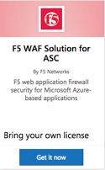
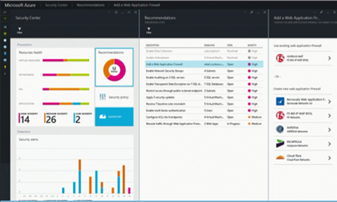
WAF Solution for Microsoft Azure (Inside ASC)
Industry leading application protection in minutes
Simple deployment experience integrated with Azure workflow and services
Deploys 2 clustered WAF’s for increased redundancy
Out-of-the-box choice of security settings preconfigured by F5 experts, plus ability to make more customized settings/policies
Comprehensive application security with advanced L7 protections
Guaranteed compliance with all leading regulatory standards
BYOL deployment, inside ASC (Azure Security Centre)
WAF Solution for ASC has Integration with Azure dashboard and alert/visualization services
Azure Security Center
Manual Deployment ~ 9 hours
Marketplace Deployment ~ 30 mins
BYOL Marketplace Offering
Notes:
Slide Objective:
Review at high level F5’s fully integrated public cloud security solutions for Azure, bring in your SE if they want to go deeper on how these work.
Talking Points
F5 is striving to simplify the process of implementing advanced security in the public cloud. These solutions are deployable direct from the marketplace and are pre-configured by F5 experts, with the option to customize policies further to suit a customers individual requirements. Bring up shared responsibility model, and how security of the cloud is responsibility of the cloud provider, secuirty in the cloud (secuirty of applications/data) is responsibility of customer.
There are PAYG & BYOL solutions, BYOL solutions require F5 Best license.
Deployable outside of, or inside ASC (Azure Security Centre – Azures security analytics/visualisation service), giving customer the flexibility to choose whether to leverage ASC or not.

Slide 34
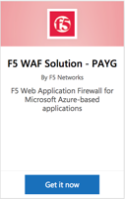
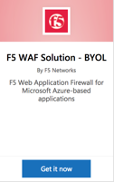
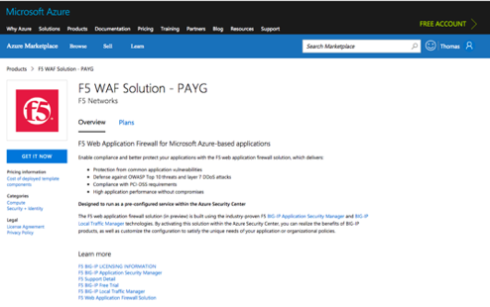
WAF Solution for Microsoft Azure (Outside ASC)
Industry leading application protection in minutes
Simple deployment experience integrated with Azure workflow and services
Deploys 2 clustered WAF’s for increased redundancy
Out-of-the-box choice of security settings preconfigured by F5 experts
Comprehensive application security with advanced L7 protections
Guaranteed compliance with all leading regulatory standards
Choice of pay-as-you go and BYOL to best fit business scenario, deployable outside of ASC (Azure Security Centre)
ASC service is not required to implement this solution
BYOL Marketplace Offering
PAYG Marketplace Offering
Manual Deployment ~ 9 hours
Marketplace Deployment ~ 30 mins

Slide 35
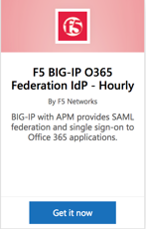
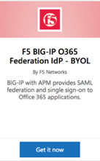
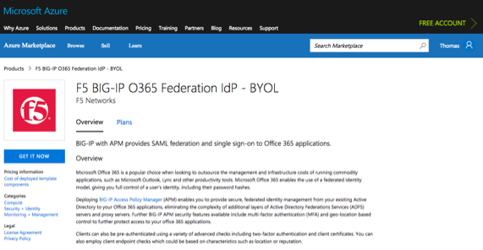
Federated Access to O365 Apps in Microsoft Azure
Secure access for Office365 Applications
Deploys an F5 built, pre-configured VE with BIG-IP APM provisioned
Leverage an existing active directory and SAML 2.0 to provide federated access to O365 applications
Extend security with other APM features including MFA, geo-location based control and device checks.
Simple deployment experience direct from marketplace and integration with Azure workflow and services
Choice of PAYG and BYOL deployments to best fit business scenario
BYOL Marketplace Offering
PAYG Marketplace Offering
Manual Deployment ~ 4 hours
Marketplace Deployment ~ 30 mins
Notes:
Slide Objective:
Review at high level F5’s fully integrated public cloud solutions for Access in Azure – bring in your SE if they want to know how it works.
Talking Points:
Provides federated access to Office 365 applications in a customers public cloud, using their existing on-premise or cloud-hosted active directory via SAML2.0 – Keep user credentials and data in a safe/secure place of your choosing.
Comes pre-configured with BIG-IP APM, other APM features such as SSO, MFA, Geo-location based access can be configured. BYOL solution requires BEST license.

Slide 36
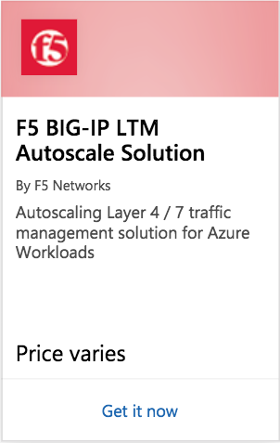
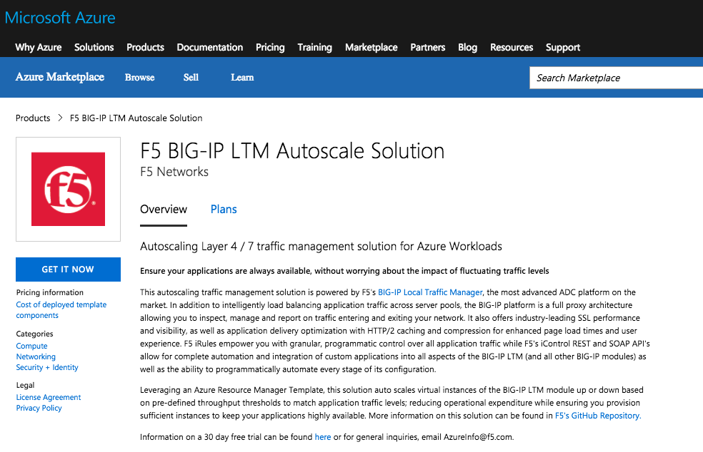
Auto Scale LTM in Azure Marketplace
Deploys BIG-IP VE with LTM provisioned in an Azure VM Scale Set that has been configured for auto scaling, to consistently provide intelligent traffic management services to applications under varying traffic loads.
As traffic increases/decreases and crosses pre-defined ‘network out’ throughput thresholds, BIG-IP LTM instances are either spun up or spun down, accordingly.
The BIG-IP VE instance operates with 1 network interface used for both management and data plane traffic.
Deployed directly from Azure marketplace via a fully integrated Azure Resource Manager template for increased agility
Azure resources required include: Azure load balancer and VM Scale Set
Manual Deployment ~ 7 hours
Templated Deployment ~ 30 mins
PAYG Marketplace Offering
Notes:
Slide Objective:
Review at high level F5’s fully integrated public cloud solutions for Access in Azure – bring in your SE if they want to know how it works.
Talking Points:
Provides federated access to Office 365 applications in a customers public cloud, using their existing on-premise or cloud-hosted active directory via SAML2.0 – Keep user credentials and data in a safe/secure place of your choosing.
Comes pre-configured with BIG-IP APM, other APM features such as SSO, MFA, Geo-location based access can be configured. BYOL solution requires BEST license.

Slide 37
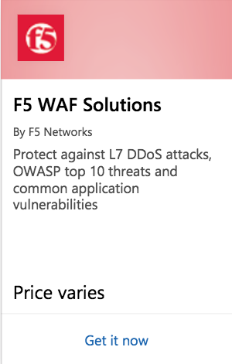
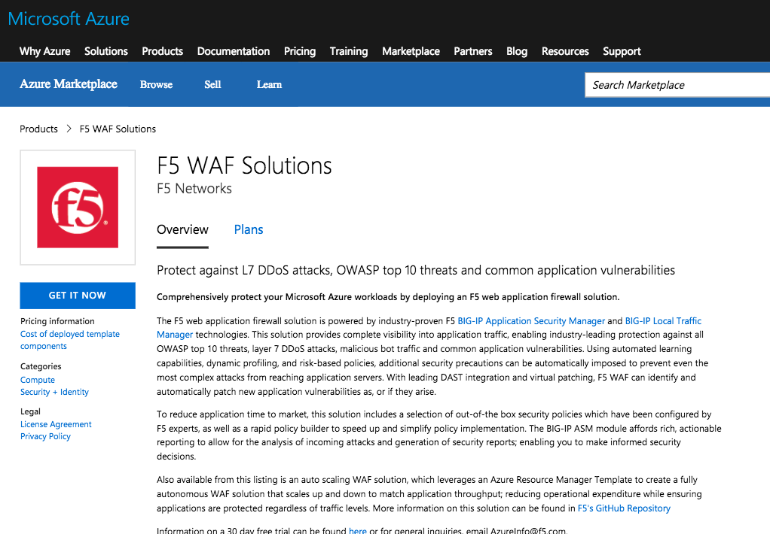
Auto Scale WAF in Azure Marketplace
Deploys VE instances with BIG-IP LTM and BIG-IP ASM provisioned in an Azure VM Scale Set that has been configured for auto scaling, to provide intelligent traffic management and application security services to applications under varying traffic loads. Instances scale up or down depending on traffic throughput, ensuring application security and operational expenditure are optimized. As traffic passes pre-defined thresholds, instances are spun up or down. Thresholds are based on ‘network out’ throughput.
Comprehensive, layer 7 application protection and guaranteed compliance with all major regulatory standards. Out-of-the-box deployment using pre-built, F5 developed, security policies – which can be customized further for more advanced policy creation
Deployed directly from Azure marketplace via a fully integrated Azure Resource Manager template for increased agility
Azure resources required include: Azure load balancer and VM Scale Set
Manual Deployment ~ 7 hours
Templated Deployment ~ 30 mins
PAYG Marketplace Offering
Notes:
Slide Objective:
Review at high level F5’s fully integrated public cloud solutions for Access in Azure – bring in your SE if they want to know how it works.
Talking Points:
Provides federated access to Office 365 applications in a customers public cloud, using their existing on-premise or cloud-hosted active directory via SAML2.0 – Keep user credentials and data in a safe/secure place of your choosing.
Comes pre-configured with BIG-IP APM, other APM features such as SSO, MFA, Geo-location based access can be configured. BYOL solution requires BEST license.

Slide 38
OpenStack Template Updates/Notes – Release 8
BIG-IP v13.1.0.2 Support
All supported templates now support BIG-IP v13.1.0.2

Slide 39
VMWare Template Updates/Notes – Release 8
NEW!
EXPERIMENTAL Standalone 3NIC
Deploys a standalone, BYOL BIG-IP VE instance with 3 network interfaces in a VMWare environment. This template will be fully supported in future releases.

Slide 40
Supported Private Cloud Solution Templates
1NIC Architecture
2NIC Architecture
n-NIC Architecture
HA Pair (A/S 2NIC)
1NIC Architecture
1NIC Architecture

Slide 41
1-NIC BIG-IP VE Deployment in OpenStack
For deploying single, standalone BIG-IP device(s) with one network interface
Deploys a standalone BIG-IP VE in a pre-existing OpenStack Private Cloud, where traffic automatically flows via the VE to the application servers. The BIG-IP instance operates with 1 network interface, processing both management and data plane traffic from the internet. This is the set-up most cloud native developers are accustom to and is best for single tenant or ‘per app’ services.
Only BYOL templates available
Pre-requisites to this template can be found here
OpenStack Private Cloud
Manual Deployment ~ 3+ hours
Templated Deployment ~ 40 mins
Link to GitHub

Slide 42
2-NIC BIG-IP VE Deployment in OpenStack
For deploying single, standalone BIG-IP device(s) with two network interfaces
Deploys a standalone BIG-IP VE in a pre-existing OpenStack Private Cloud, where traffic automatically flows via the VE to the application servers. The BIG-IP instance operates with 2 network interfaces, one for management & data-plane traffic from the internet and another connected into the Neutron network where traffic is processed by pool members
Only BYOL templates available
Pre-requisites to this template can be found here
OpenStack Private Cloud
Manual Deployment ~ 3+ hours
Templated Deployment ~ 40 mins
Link to GitHub

Slide 43
Multi-NIC BIG-IP VE Deployment in OpenStack
For deploying single, standalone BIG-IP device(s) with 3+ network interfaces
Deploys a standalone BIG-IP VE in a new or existing virtual network, where traffic automatically flows via the VE to the application servers. The BIG-IP VE instance is launched with 3 network interfaces but the template has the capability to add additional interfaces (up to a total of 8). This template is useful when the VE is acting as a traffic controller requiring more than 3 interfaces.
Multi-NIC configurations are necessary when deploying multiple applications on different IP addresses, or multi-tenant configurations.
BYOL and PAYG templates available
Pre-requisites to this template can be found here
OpenStack Private Cloud
Manual Deployment ~ 3+ hours
Templated Deployment ~ 40 mins
Link to GitHub

Slide 44
HA Pair Deployment in OpenStack
For deploying 2 BIG-IP VE’s in an active/standby configuration for increased availability
Launches and configures two BIG-IP VE’s in a single availability zone in an Active-standby arrangement for high availability, such that should one BIG-IP fail, traffic is automatically re-directed to the unaffected device until the issue is resolved.
The BIG-IP instance operates with 2 network interfaces:
One for management & data-plane traffic from the internet
Another connected into the Neutron networks where traffic is processed by pool members.
Only BYOL templates available
Pre-requisites to this CFT can be found here
OpenStack Private Cloud
Manual Deployment ~ 8+ hours
Templated Deployment ~ 40 mins
Link to GitHub

Slide 45
1-NIC BIG-IP VE Deployment in Azure/Azure Stack
For deploying a single, standalone BIG-IP device with one network interface
Deploys a standalone BIG-IP VE in a new or pre-existing Azure virtual network, where traffic automatically flows via the VE to the application servers. The BIG-IP instance operates with 1 network interface, processing both management and data plane traffic from the internet. This is the set-up most cloud native developers are accustom to and is best for single tenant or ‘per app’ services.
BYOL and PAYG templates available
Pre-requisites to this template can be found here
Link to GitHub
Manual Deployment ~ 3+ hours
Templated Deployment ~ 40 mins

